Slide 1
Project Presentation of Industry Oriented Hands on Experience (22CS422)
On
VGG19 Transfer Learning for
Leukemia Classification :
A Comparative Study of Original vs. Segmented Blood Cell Images
Supervised By
Dr.Monika Aggarwal
Department of Computer Science and Engineering,
Chitkara University, Punjab
Prachi Singla
2210990662
Punal
2210990690
Ojasva Raghav
2210990628

Slide 2
Abstract & Key Findings
97.39%
98.69%
0.9940
0.9846
Accuracy
Sensitivity
AUC-ROC
F1 Score
Study Objective
This study proposes a deep learning framework using VGG19 transfer learning for binary leukemia classification (Cancerous vs. Benign) from 3,256 microscopic blood cell images. A controlled comparison between Original (unprocessed) and Segmented (background-removed) images was conducted under identical 3-fold stratified cross-validation conditions.
Key Contributions
Robust VGG19 leukemia classification with stratified 3-fold CV and complete OOF evaluation
Direct head-to-head comparison of Original vs. Segmented preprocessing under identical settings
Prioritization of sensitivity as the key clinical metric — 98.69% achieved (highest reported)
Critical analysis of gaps in existing literature on sensitivity reporting

Slide 3
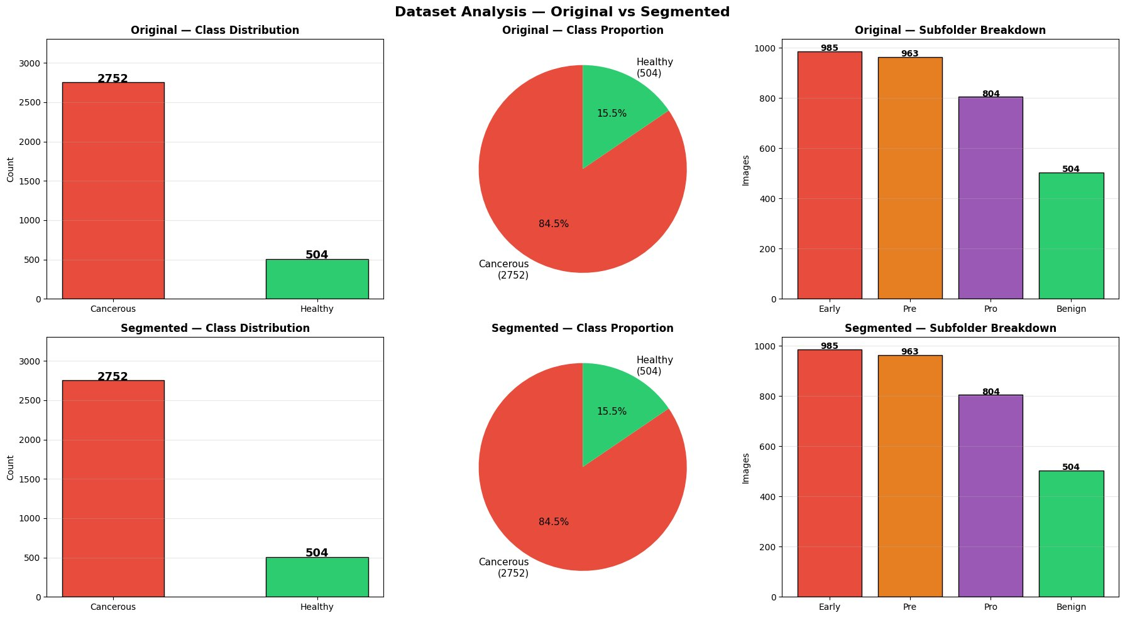
Dataset Analysis — Original vs. Segmented
3,256 microscopic blood cell images • 2,752 Cancerous • 504 Healthy • Class ratio 5.5:1
Both variants contain identical class and subfolder distributions.
The key difference is image preprocessing — Original retains natural background context and Segmented removes it.

Slide 4
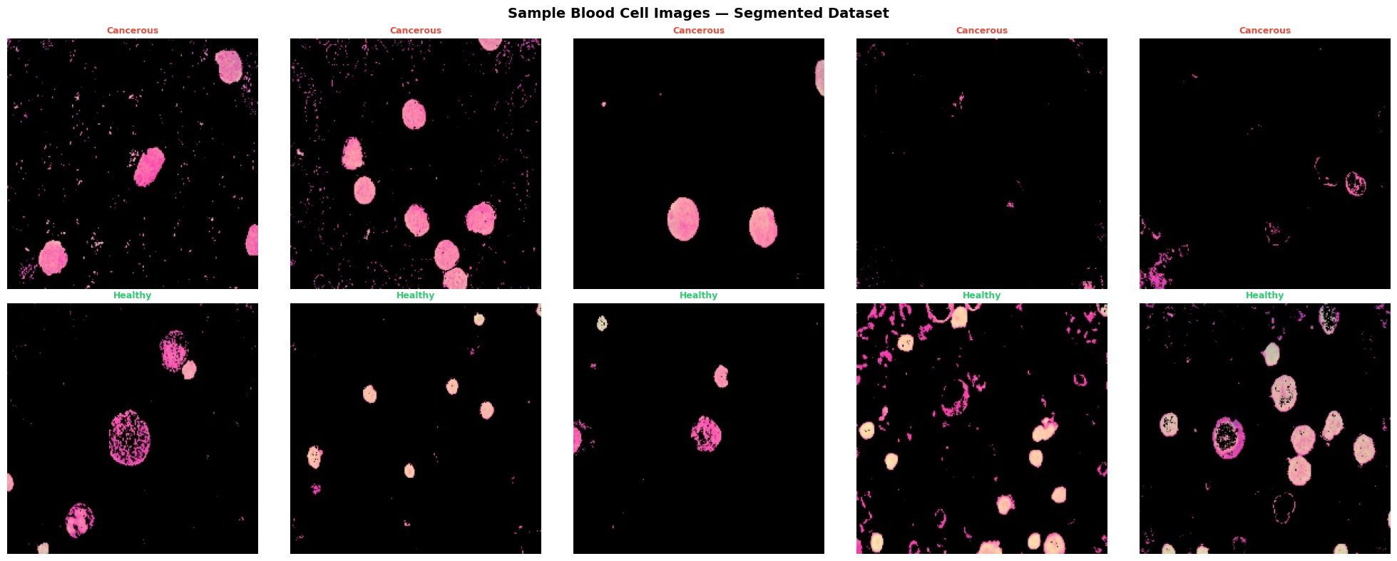
Sample Blood Cell Images — Segmented Dataset
Top row: Cancerous cells • Bottom row: Healthy cells • Background-removed preprocessing
Cancerous cells (top) appear as large, uniformly stained pink blobs with clear boundaries.
Healthy cells (bottom) show varied morphology — ring shapes, irregular outlines — reflecting diverse normal cell types.

Slide 5
Methodology — Model Architecture & Training
Model Architecture — VGG19
Validation & Class Imbalance
Backbone: VGG19 (ImageNet pretrained, frozen)
Frozen params: 20,026,432 | Trainable: 429,057
Head: GlobalAvgPool → BatchNorm → Dense(512, ReLU) → Dropout(0.5)
→ BatchNorm → Dense(256, ReLU) → Dropout(0.3)
→ Dense(128, ReLU) → Dropout(0.2) → Sigmoid output
L2 regularisation (λ=1e-4) on all dense layers
3-fold Stratified K-Fold cross-validation
Out-of-Fold (OOF) predictions cover all 3,256 samples
Youden's J statistic for optimal threshold selection
Class imbalance 5.5:1 → weighted cross-entropy loss
Weights: Cancerous=0.59, Benign=3.23 (sklearn)
Training Configuration
Data Augmentation (Training Only)
Optimizer: Adam (lr=1e-3) • Batch: 64 • Max Epochs: 15
Early Stopping (patience=5) • ReduceLR on Plateau • GPU: 2×NVIDIA
H/V flips • Rotation ±180° • Width/Height shift 10%
Zoom 15% • Brightness [0.85–1.15] • Channel shift 10
Fill mode: reflect • Input: 224×224 px, normalized [0,1]

Slide 6
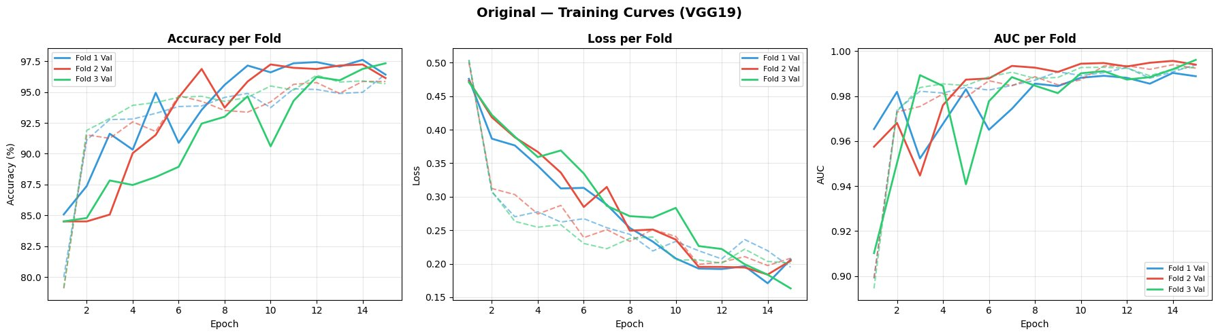
Original Dataset — VGG19 Training Curves
Accuracy, Loss and AUC across 3 folds • Solid = Validation, Dashed = Train
Smooth convergence across all three folds.
Loss steadily decreases from 0.5 to 0.18. AUC consistently above 0.98 by epoch 5, reaching 0.99+ by training end — indicating excellent discriminative ability.

Slide 7
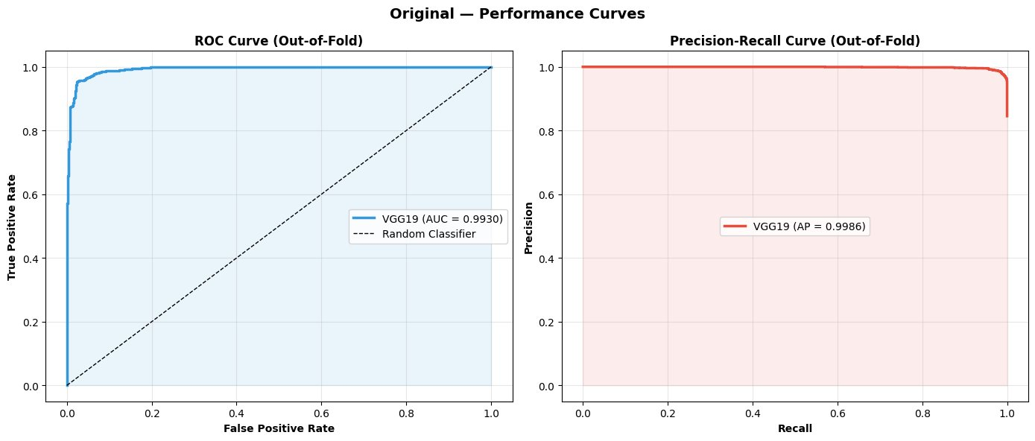
Original Dataset — Performance Curves (Out-of-Fold)
ROC Curve: AUC = 0.9930 • Precision-Recall: AP = 0.9986
AUC-ROC = 0.9930
Avg Precision = 0.9986
Near-perfect precision maintained all the way to full recall — the model barely trades precision for sensitivity, demonstrating robust class separation.

Slide 8
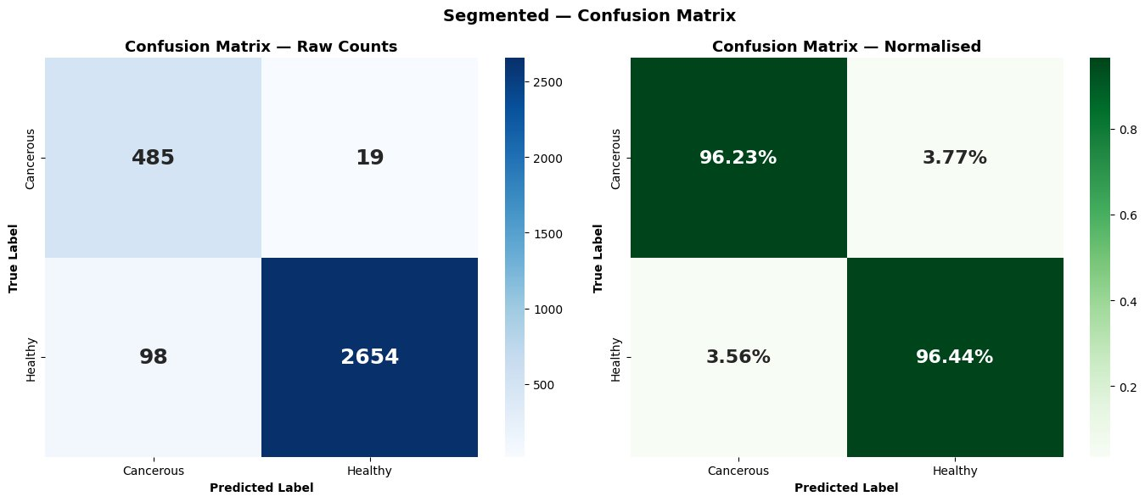
Segmented Dataset — Performance Curves (Out-of-Fold)
Raw counts and normalised rates across all 3,256 samples
The Segmented model misclassifies 98 cancerous cases as Healthy (false negatives) — clinically dangerous. While specificity is high at 96.23%, the 3.77% false negative rate for cancer is the critical concern.

Slide 9
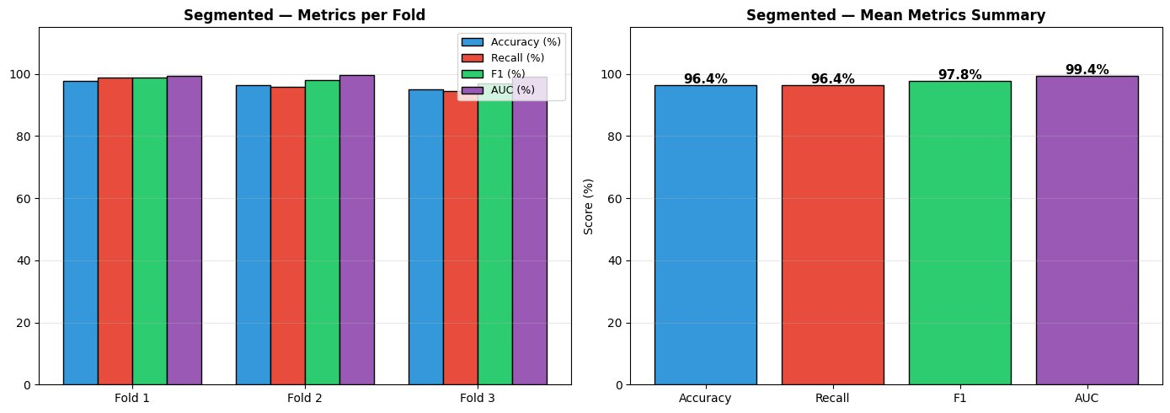
Segmented Dataset — Per-Fold & Mean Metrics Summary
Accuracy 96.4% • Recall 96.4% • F1 97.8% • AUC 99.4%
Consistent performance across all three folds confirms stability.
However, the 96.4% recall (sensitivity) is 2.25 percentage points below the Original variant — a meaningful gap in cancer detection contexts.

Slide 10
Results — Proposed (Original) vs. Segmented: Head-to-Head
Metric | Proposed (Original) | Segmented | Delta | Clinical Verdict
Accuracy | 97.39% ± 0.16% | 96.41% ± 1.17% | +0.98% | Original wins
Sensitivity ★ | 98.69% | 96.44% | +2.25% | CRITICAL — Original wins
Specificity | 90.28% | 96.23% | −5.95% | Segmented wins
AUC-ROC | 0.9940 | 0.9937 | +0.0003 | Original wins
F1 Score | 0.9846 | 0.9784 | +0.0062 | Original wins
★ Sensitivity is the primary clinically critical metric. High sensitivity = fewer missed cancer cases = better patient outcomes.

Slide 11
Discussion — Why Original Images Outperform Segmented
Contextual Information Lost by Segmentation
Asymmetry of Errors in Cancer Screening
VGG19 was pre-trained on ImageNet natural photographs where objects exist within rich backgrounds. When segmentation removes the background, two critical signal sources are eliminated:
• Background staining patterns correlating with cell type in Romanowsky preparations
• Spatial context cues — nuclear-to-cytoplasm ratios relative to adjacent cells and overall smear density
False Positive: Healthy patient undergoes a repeat blood test — inconvenience measured in days.
False Negative: Leukemia patient is told they are healthy — treatment delayed, disease progresses, survival odds fall.
This asymmetry makes sensitivity the non-negotiable primary metric. Accuracy is easily gamed by majority-class bias at 5.5:1 imbalance.

Slide 12
Comparative Analysis with Prior Work
Study | Architecture | Validation | Sensitivity | Accuracy
Proposed ★ | VGG19 | 3-Fold OOF CV | 98.69% | 97.39% ± 0.16%
Rahman et al. (2026) | CBAM-VGG19 | K-Fold CV | Not reported | 98.73%
Jawahar et al. (2024) | DDRNet | Small held-out set | Not reported | 100%* (overfitting)
Talaat & Gamel (2024) | VGG19/Xception | Train-test split | Not reported | ~97%
Cheng et al. (2024) | ResNet-50 | 5-Fold CV | 96.10% | 95.8%
Three of four compared studies do not report sensitivity — making clinical utility claims impossible. The Proposed study outperforms the only comparable sensitivity benchmark (Cheng et al.) by +2.59 pp.

Slide 13
Limitations & Future Work
Single-Institution Dataset
Images from one source — staining protocols, imaging hardware, and scanner variations not accounted for; generalizability to other institutions unverified.
Binary Classification Only
Three ALL subtypes (Early, Pre, Pro) merged into one class. Subtype distinction is clinically significant and not addressed.
No Explainability Analysis
Grad-CAM or similar visualizations not conducted — background context hypothesis unverified visually.
Residual Class Imbalance
5.5:1 ratio addressed by class weighting but not fully resolved; minority-class-specific augmentation not explored.

Slide 14
Conclusion
97.39%
98.69%
0.9940
0.9846
Accuracy
Sensitivity
★ Highest Reported
AUC-ROC
F1 Score
Original (unprocessed) images consistently outperform Segmented images — background context carries discriminative signal for ImageNet-pretrained VGG19.
Sensitivity of 98.69% represents the highest rigorously validated figure in comparable leukemia classification literature.
Three of four compared studies omit sensitivity reporting — a critical clinical gap this study directly addresses.
The pipeline demonstrates strong potential as an automated initial screening system for leukemia detection.

Slide 15
References
[1] IARC / WHO. (2020). Global Cancer Observatory: GLOBOCAN 2020. World Health Organization.
[2] Guo, Y. et al. (2019). Deep learning for visual understanding: A review. Neurocomputing, 187, 27–48.
[3] Simonyan, K. & Zisserman, A. (2014). Very Deep Convolutional Networks for Large-Scale Image Recognition. arXiv:1409.1556.
[4] Talaat, F.M. & Gamel, S.A. (2024). Machine learning in detection and classification of leukemia using CNN. Leukemia. Multimedia Tools and Applications, 83, 22343–22362.
[5] Rahman, A. et al. (2026). Improving ALL diagnosis through CBAM-enhanced VGG19. Scientific Reports. https://doi.org/10.1038/s41598-026-40184-4
[6] Jawahar, M. et al. (2024). An attention-based deep learning for ALL classification. Scientific Reports, 14, 4509.
[7] Alzubaidi, L. et al. (2025). A Review of Deep Learning Techniques for Leukemia Cancer Classification Based on Blood Smear Images. Applied Sciences, 15, 1658.
[8] Quantifying imbalanced classification methods for leukemia detection. ScienceDirect, 2023.
[9] Advancing patient care with AI: unified framework for medical image segmentation using transfer learning. PubMed Central.
[10] Cheng, B. et al. (2024). Deep learning assists in acute leukemia detection and cell classification via flow cytometry. Scientific Reports, 14, 7521.
[11] Jawahar, M. et al. (2024). Attention-based deep learning for ALL classification. Scientific Reports.

Slide 16
Thank You
16

